Slide 1
Atlas Itinerary
By Gabriel Taylor, Dustin Zook, Sorelle Djuissi, Gabriyel Sorensen

Slide 2
Storyboard

Slide 3
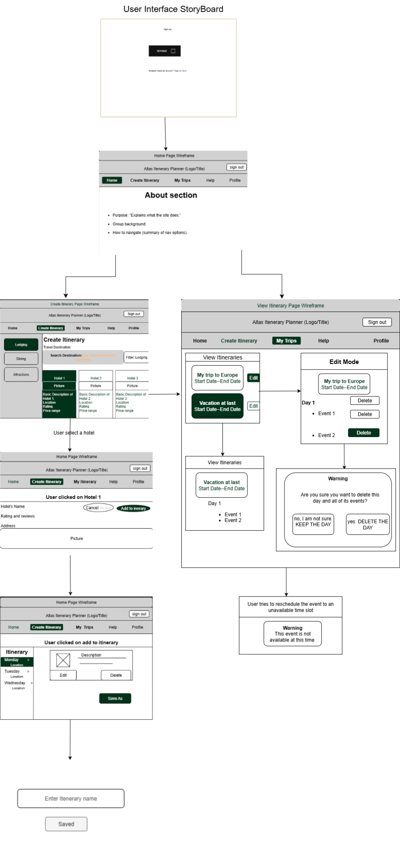

Slide 4
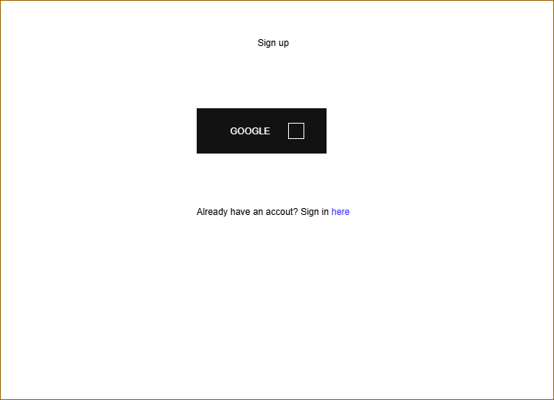
Sign-up and sign in page
Google API backbone
Link to Sign-in page

Slide 5
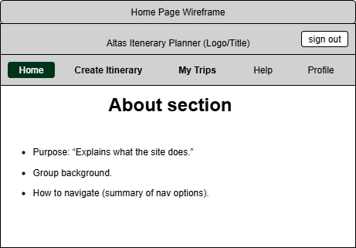
The Home Page
About Section
Instructions
Personnel
Nav Bar

Slide 6
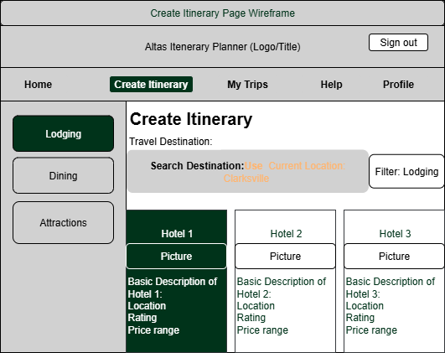
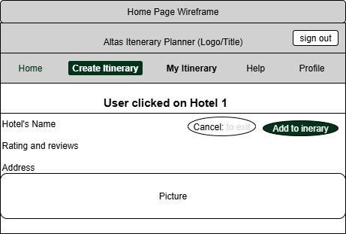
Create Itinerary
Travel destination
Geolocating
Location categories
Subcategories in the filter
Successful Completion

Slide 7
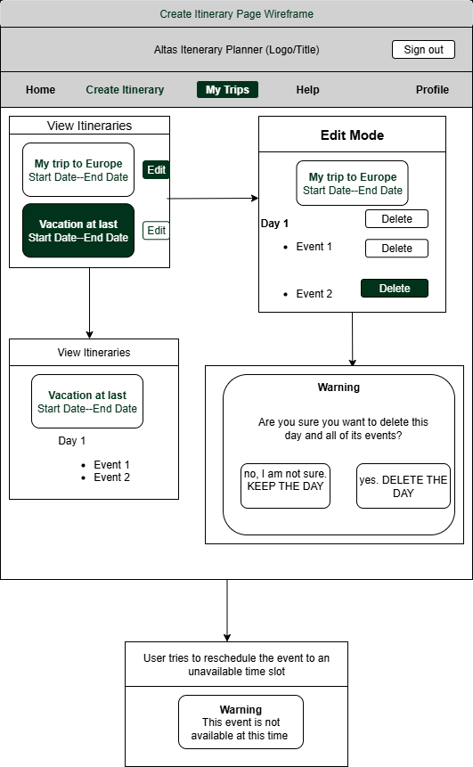
View Itinerary
Empty Page
Card Presentation (and Contents)
Expanded cards
Edit mode (both event and day)
Warning

Slide 8
The Components

Slide 9
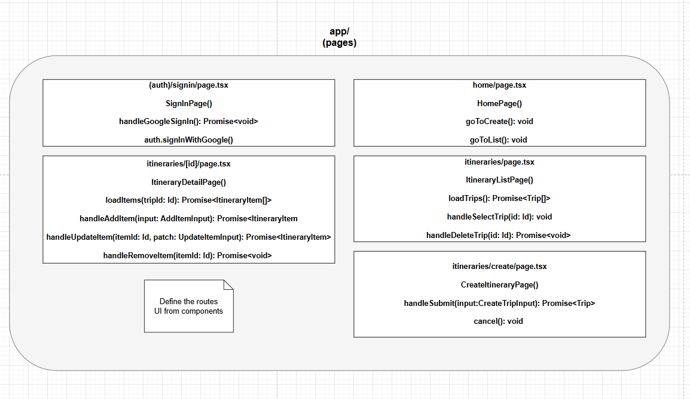

Slide 10
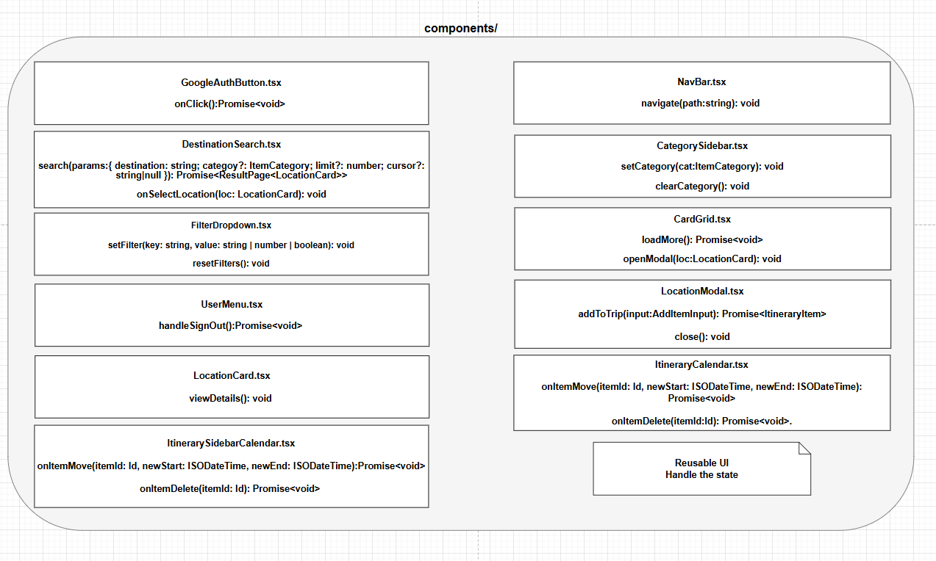

Slide 11
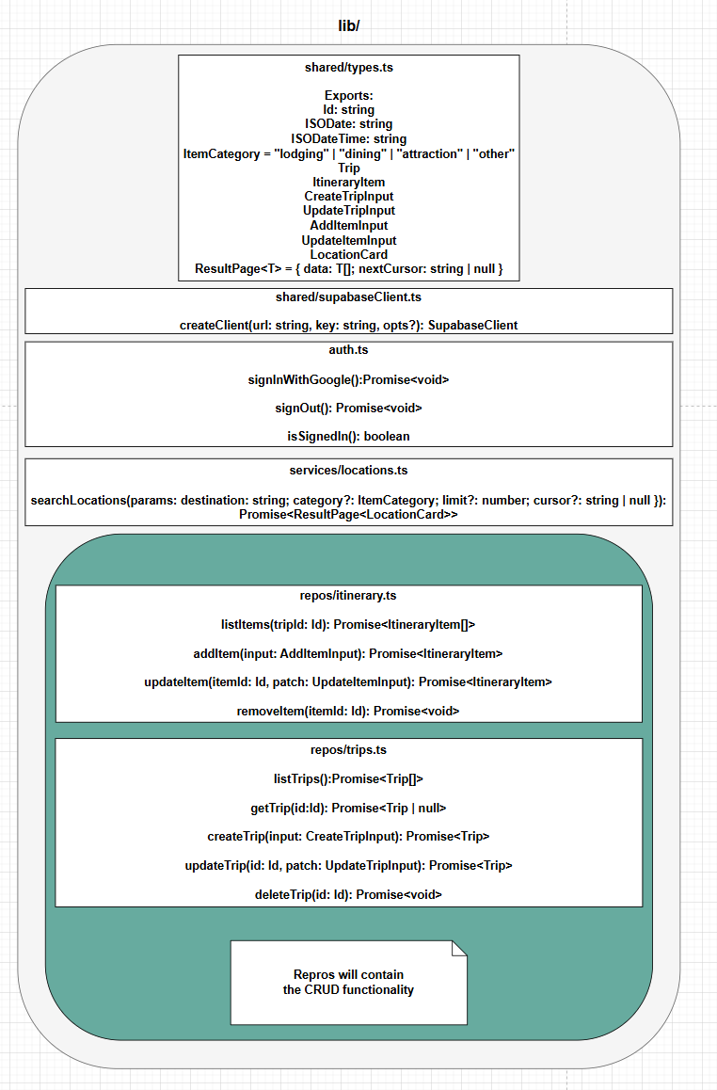

Slide 12
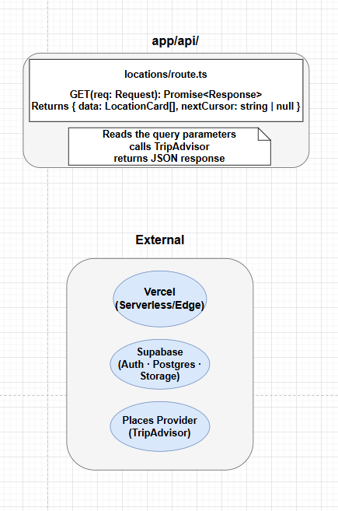

Slide 13
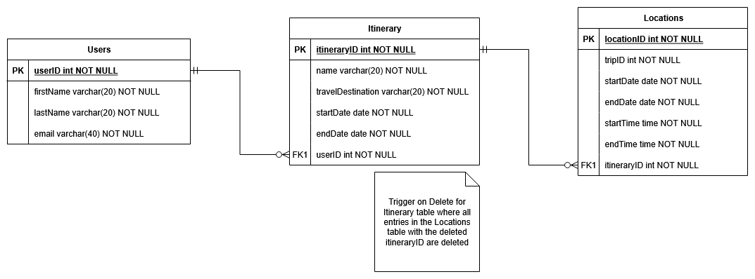
Storage Documentation - ER Diagram

Slide 14
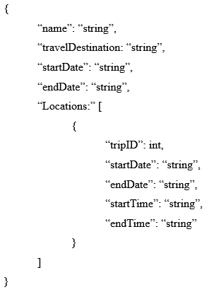
Message Documentation - Save Itineraries

Slide 15
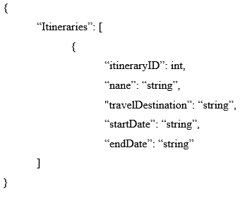
Message Documentation - View Itineraries

Slide 16
Questions?

